Slide 1
Module | Predictive Analytics - Classification | Application of Classification Models Classification using Logistic Regression Classification using Naive Bayes model
 |  | Confusion Matrix - Accuracy, Precision & Recall Model Interpretation AUROC Case Study: Loan Prediction

Slide 2

Introduction To
Logistic
Regression

Slide 3
Supervised
Machine
Learning
Types Of Problem
Statement
Classification
Regression
Used when dependent variable is categorical.
Used when dependent variable is continuous

Slide 4
What is Logistic Regression?
In Linear Regression, We quantify the relationship between dependent variable and independent variable. But what will happen if our dependent variable is in the form of binary categories. In these situations, we use Logistic Regression .
The binary outcome have two potential values, usually an observation
belongs to a certain category or has satisfied some particular attribute going to be a yes/no question.
Logistic Regression calculates the probability and tells that a predicted
value belongs to a specific class.

Slide 5
Lets Explore an Example:
Table shows a table that contains the ice-cream sales data for an ice-cream shop. For now, you are recording just two variables: the age of the customer and whether she buys ice cream. The data set has an indicator variable called “Buy_ind”, which takes a value of 0 if a customer buys ice cream and a value of 1 if not. You are asked to predict ice-cream sales using age as an independent variable.
Age
Buy_id
6
0
25
0
32
1
44
1
34
1
43
1
72
1
67
0
58
1
15
0
42
1

Slide 6
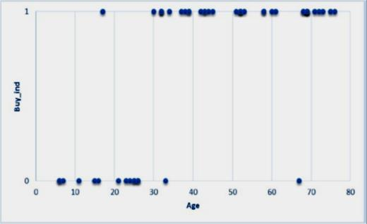
Lets Explore an Example:
Let’s create a scatter plot showing dependent variable on y-axis
i.e. “Buy_ind”
and
independent variable
on x-axis
i.e.
“Age”.
When you take a close look at the data,
you can easily observe a pattern in it. You
can see that when customer is younger, the buy_ind variable is 0 most of the time, and when customer is older; buy_ind is 1 most of the time.
This shows that older people are not
buying ice cream.

Slide 7
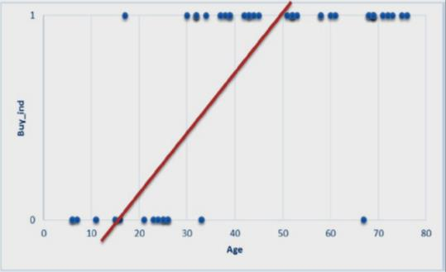
Let's Explore an Example:
The data has some apparent pattern, but you are not able to capture it using the linear regression models. Maybe a linear regression line is not a good fit for this data . As the probability can only take values between 0 to 1 , we need a different approach to ensure that our model is appropriate for the data .

Slide 8
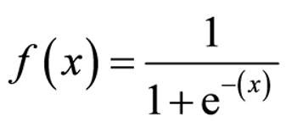
x
And for logistic regression, we calculate probability, i.e. y is the probability of a given variable
belonging to a certain class. Thus, it is obvious that the value of y should lie between 0 and 1 and we
need a probabilistic function to get the probabilities between 0 to 1
Problems with Linear Regression equation :
- Presence of outliers in the data will lead to misclassification of values if we use linear regression
equation i.e. a value belonging to class 1 can wrongly be misclassified in class 0 .
So, we need to use such an equation which always gives values between
calculating the probability.
0 and 1, as we desire while
So, we use Sigmoid Function which is given by :
f(x) = output between 0 and 1 (probability estimate)
x= input to the function (your algorithm’s prediction e.g.
This function will give results between 0 to 1 for any value of x.

Slide 9
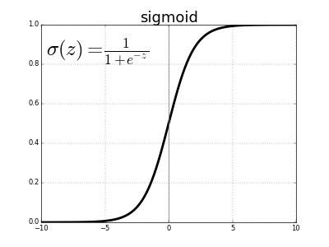
SIGMOID FUNCTION
•A sigmoid function is a mathematical
function having a characteristic "S"-shaped curve
or sigmoid curve.
•A common example of a sigmoid function is
the logistic function. In order to map predicted
values to probabilities, we use
the sigmoid function.
•The function maps any real value into
another value between 0 and 1.

Slide 10
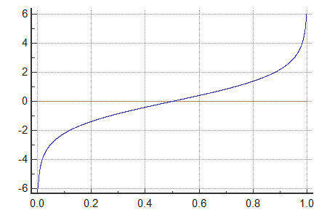
LOGIT FUNCTION
•The Logit function or the log-odds is
the logarithm of the odds
p / (1-p) where p is probability.
•It is a type of function that creates a map of
probability values from (0,1) to (-∞,+ ∞).

Slide 11

LOGIT FUNCTION
•It is the inverse of the sigmoid "logistic"
function.
•If p is a probability, then p/ (1 − p) is the
corresponding odds; the logit of the probability is the logarithm of the odds, i.e.

Slide 12
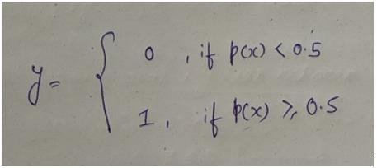
Predictions And Threshold
Our prediction function returns a probability score
between 0 and 1.
In order to map this to a discrete class (0/1, yes/no), we
select a threshold value or tipping point above which we will classify values into class 1 and below which we classify values into class 2.
p≥0.5,class=1
p<0.5,class=0
Reference : ML Glossary

Slide 13
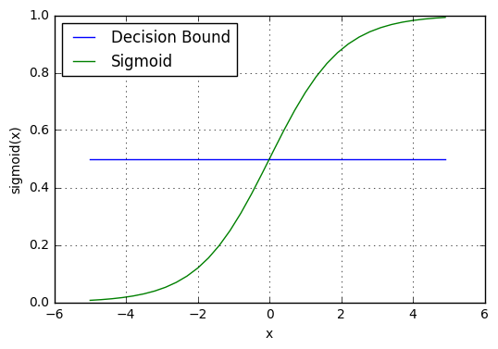
Predictions And Threshold
For example, if our threshold was .5 and our prediction
function returned .7, we would classify this observation as
positive (class 1).
If our prediction was .2 we would classify the observation as
negative (class 0) .
Reference : ML Glossary

Slide 14
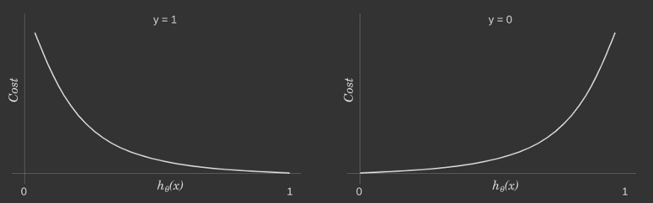
Cost Function
called Cross-Entropy, also known as Log Loss
-log(h(x))
-log(1- h(x))
In the above graph ,
The figure on left hand side is for y=1 , where we can see, when the predicted probability (x-axis)
is close to 1, the cost is less and when the predicted probability is close to 0, loss approaches
infinity.
The figure on right hand side is for y=0 , where we can see, when the predicted probability (x-axis)
is close to 0, the cost is less and when the predicted probability is close to 1, loss approaches
infinity.

Slide 15

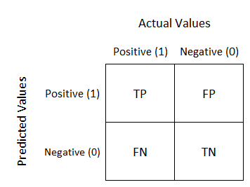
Confusion Matrix:
It is a tabular representation of Actual Vs Predicted values.
It is used to find the accuracy of our model and avoid over fitting.
It allows the visualization of the performance of an algorithm
A confusion matrix is a summary of prediction results on a
classification problem. It gives us insight not only into the errors
being made by a classifier but, more importantly, the types of
errors that are being made.
Classification
Metrics

Slide 16
Terminologies
True Positive (TP): Observation is positive, and is predicted to be positive.
You predicted that a woman is pregnant and she actually is.
False Negative (FN): Observation is positive, but is predicted negative
You predicted that a woman is not pregnant but she actually is. It is also known as Type 2 Error.

Slide 17
Terminologies
True Negative (TN): Observation is negative, and is predicted to be
negative. You predicted that a man is not pregnant and he actually is not.
False Positive (FP): Observation is negative, but is predicted positive.
You predicted that a man is pregnant but he actually is not. It is also known as Type 1 Error

Slide 18

“Out of all the total predicted positive classes ,
how many Results are actually positive”
Precision
It is also known as Positive predictive value (PPV). It is
calculated by dividing the total number of correctly
classified positive examples by the total number of
predicted positive examples.

Slide 19

“Out of all Actual Positives Values,
how much We
have predicted correctly”
Recall
It is also known as
True Positive Rate.
It is calculated as the number of correct positive predictions
divided by total number of positives.
The best sensitivity is 1.0 and worst is 0.

Slide 20

cision and
Since we have two measures (Precision and Recall)
it helps to have a measurement that represents
both of them. We calculate an F-measure,
which uses Harmonic Mean in place of
Arithmetic Mean as it punishes the extreme values more.
F1 Score
The F-Measure will always be nearer to the
smaller value of Precision or Recall.

Slide 21
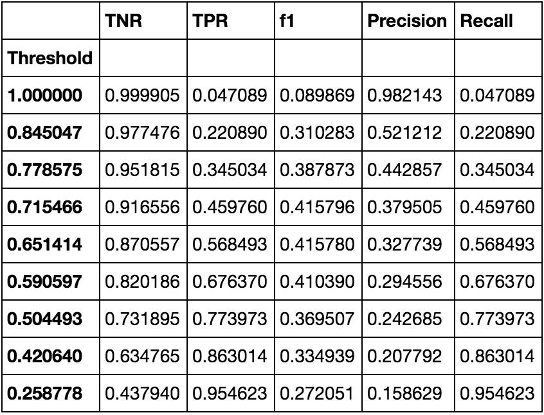
Metrics at Different Threshold
An Example showing change in Metrics
With different threshold value.

Slide 22

Implementation
Implementing Logistic Regression:
From sklearn.linear_model import LogisticRegression
Model= LogisticRegression( )
Model.fit(X_train, y_train)
Model.predict(X_test)

Slide 23

Thank you
Lets move on to Naive Bayes model

